Slide 1
CHCCOM003 Develop workplace communication strategies Session 1

Slide 3
Develop Workplace Communication Strategies:
Unit learning objectives, Assessment Guide and Tasks, Unit Outline​
Communication and common barriers​
Communication protocols and etiquette​
Making the most of being a student at Chisholm

Slide 4
10 SESSION UNIT
Communication in the workplace​
Unit learning objectives ​
Assessment Guide ​
Assessment Tasks ​
Unit Outline

Slide 5
1. Develop Communication Strategies​ 2. Establish Communication Protocols​ 3. Promote the use of communication strategies​ 4. Review communication strategies
Unit Elements

Slide 6
* Identify processes for adapting communication strategies to suit a range of contexts​ * Develop processes and protocols in line with communication strategies​ * Prepare information and resources to support the implementation of communication protocols
Establish Communication Protocols

Slide 7
Promote the use of Communication Protocols
Present information to staff regarding communication strategies, protocols and organisation standards​
Model effective oral and written communication and provide mentoring and/or coaching​
Maintain work related networks and relationships to meet organisation objectives

Slide 8
Review communication strategies
Obtain feedback from others to assess communication outcomes​
Record lessons learned and identify opportunities for continuous improvement

Slide 9
Assessment Guide
Assessment Tasks
Due Dates
Assessment 1- Questions – week 6 – 16/3/23
Assessment 2 – Project – week 9 – 6/4/23
Assessment 3 – Presentation – weeks 10-12, 13th, 20th & 27th April 2023

Slide 10
What is Communication?
the act of conveying information for the purpose of creating a shared understanding. ​
comes from the Latin “communis,” meaning “to share,” ​
includes verbal, non-verbal and electronic means of human interaction. ​
All communication involves a speaker or sender of information, a message, and an audience or recipient. ​
The sender and recipient must be able to understand each other for communication to be successful.

Slide 11
Communication Model
The communication Model explained (encoding/decoding/barriers/channels and contexts
https://www.youtube.com/watch?v=Btj94IHVc6I

Slide 12
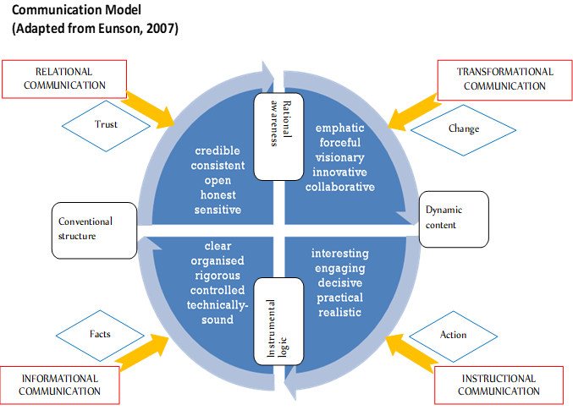

Slide 13
Who do we communicate with?-Activity
In small groups brainstorm who we communicate with in Community Services​
Circle the internal audiences​
Underline the external audiences (stakeholders)​
Feedback to large group

Slide 14
Who do we communicate with?
Co-workers (from diverse communities)​
Supervisors / managers​
admin/reception​
Community groups​
Families​
Other services providers​
Funding body​
Local & state government officials ​
Police ​
Etc. etc.

Slide 15
How do we communicate?​
Communication Channels
Communication channels refer to the way information flows within the organization and with other organizations. ​
Information can flow upwards, downwards or sideways.

Slide 16
Communication Channels
Can be Formal: ​ Such as organization newsletters, business plans​ ​
Informal: ​ Including lunchtime, team work​ ​
Unofficial: ​ For example grapevine, social gatherings amongst

Slide 17
Communication Channels include a mix of digital and “traditional” media
Emails​
Intranet/Internet​
Posters/Banners​
Newsletters/Magazines​
Events​
Meetings​
Social media​
Noticeboards

Slide 18
Professional Communication
Involves choices, influenced by: ​
organization/agency communication policies and protocols​
professional body standards and ethics​
Your role and your relationship​
Informal as well as formal​
communication channels at your disposal

Slide 19
Professional Communication
Australian Association of Social Workers Practice Standards (2013), Standard 6: ​
​
Communication and Interpersonal Skills​
​
6.1 Effectively communicate with a diverse range of people​
6.2 Effectively communicate the details and nature of the service offered to people​
6.3 Effectively work with others in a team environment​
6.4 Use information technology to communicate and provide services as appropriate ​
​
​
[PDF]Practice Standards - AASW​
https://www.aasw.asn.au/document/item/4551​

Slide 20
Summary
Communication in the workplace​
Unit learning objectives ​
Assessment Guide and Tasks ​
Unit Outline​
What is communication?​
Chisholm-communication protocols and etiquette

Slide 21
References and Links
Eunson, B. (2007). Communication in the Workplace. John Wiley and Sons Australia Limited​
​
Australian Association of Social Workers, Practice Standards​
[PDF]Practice Standards - AASW​
https://www.aasw.asn.au/document/item/4551​
​
Business Insider, Communication Etiquette Rules Every Professional Needs to Know​
https://www.businessinsider.com.au/professional-communication-etiquette-rules-2013-12​
​
Chisholm, Using Social Media​
http://insight.chisholm.edu.au/BrandStyleTemplates/Pages/Social-media.aspx

